Slide 1
iCatching
CDR Presentation
Tom Queen
Daniel Turner
Demetrius Zaibo

Slide 2
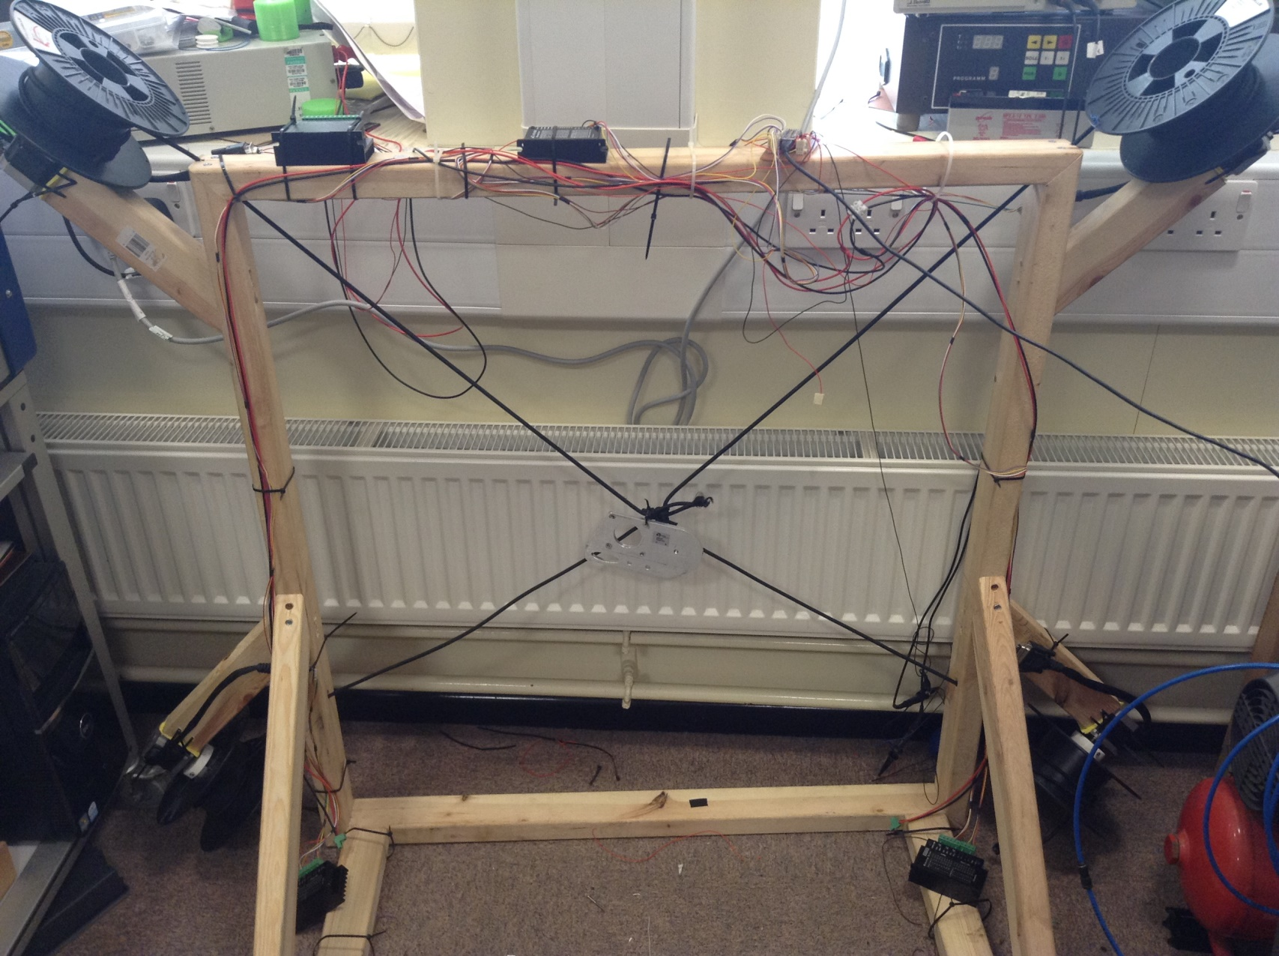
Status: Frame
Kinematics Implemented
Error Sources:
Rounding errors from using floats on a microcontroller
Discrete time system
Doesn’t whack against frame sides or oscillate
Boundary checks with hysteresis return
Input dead-band before gripper will move
Motors are naff
Can’t increase the system tension by any appreciable amount
Steppers skip and spools slip
Demo!

Slide 3
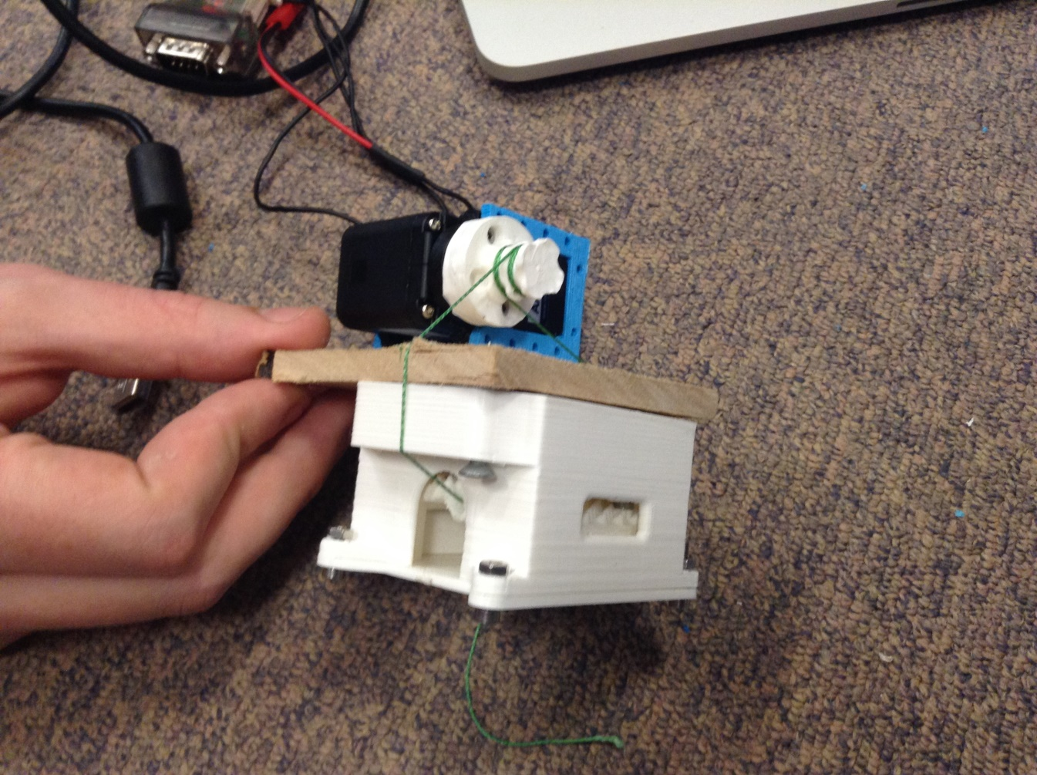
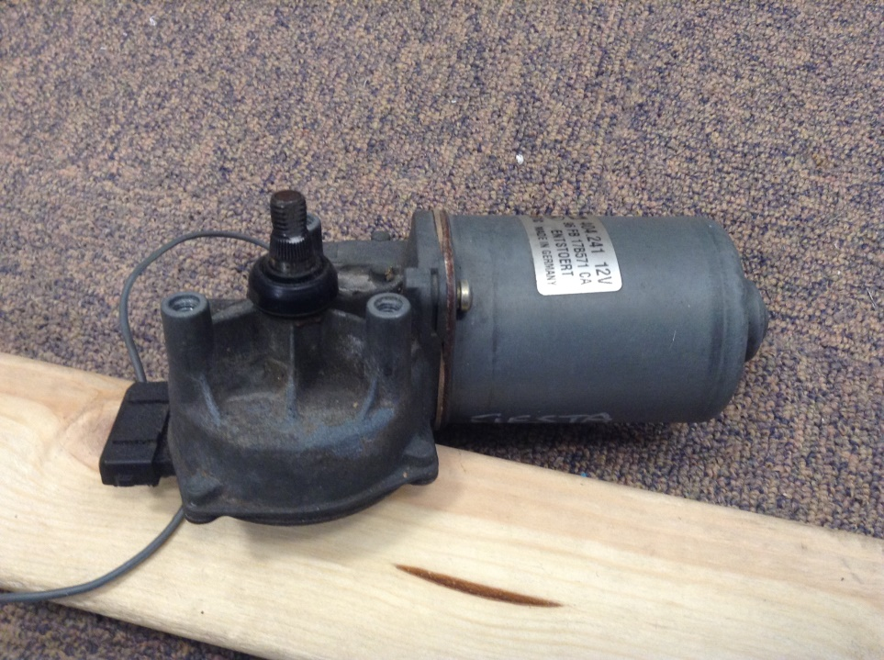
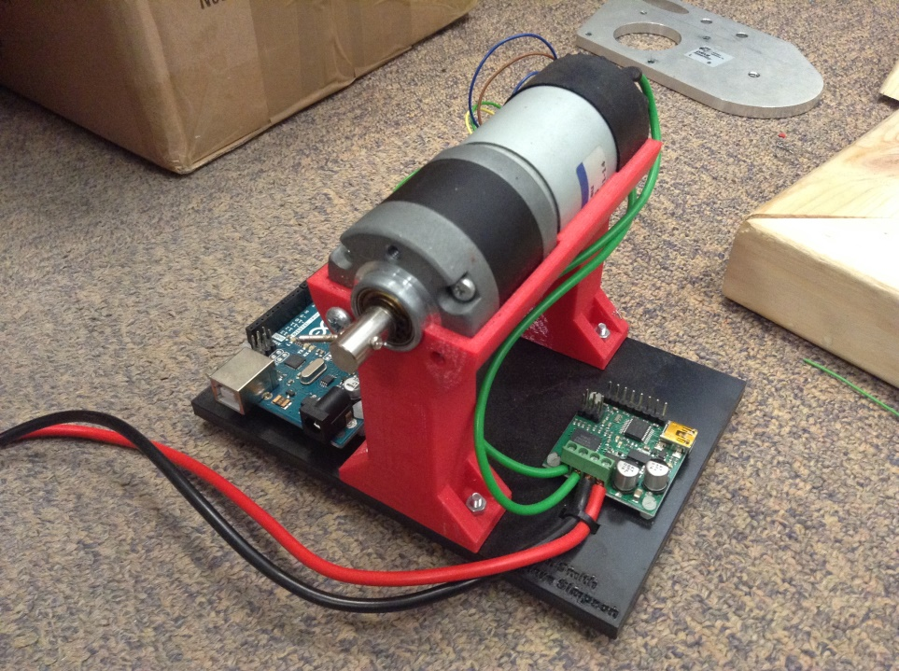
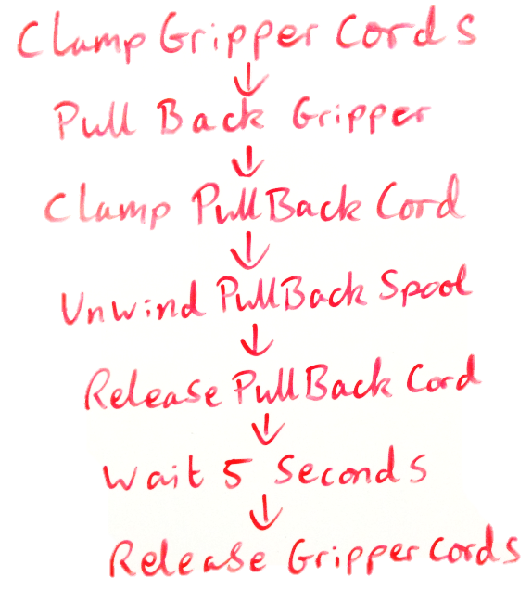
Status: Throwing
Motor inadequacy workaround: Clamps for all cables
Went through various design iterations
Intention is to use a different motor for the pullback mechanism
Same spool, but need a new spool to motor connection
Flow diagram for the control system is finished

Slide 4
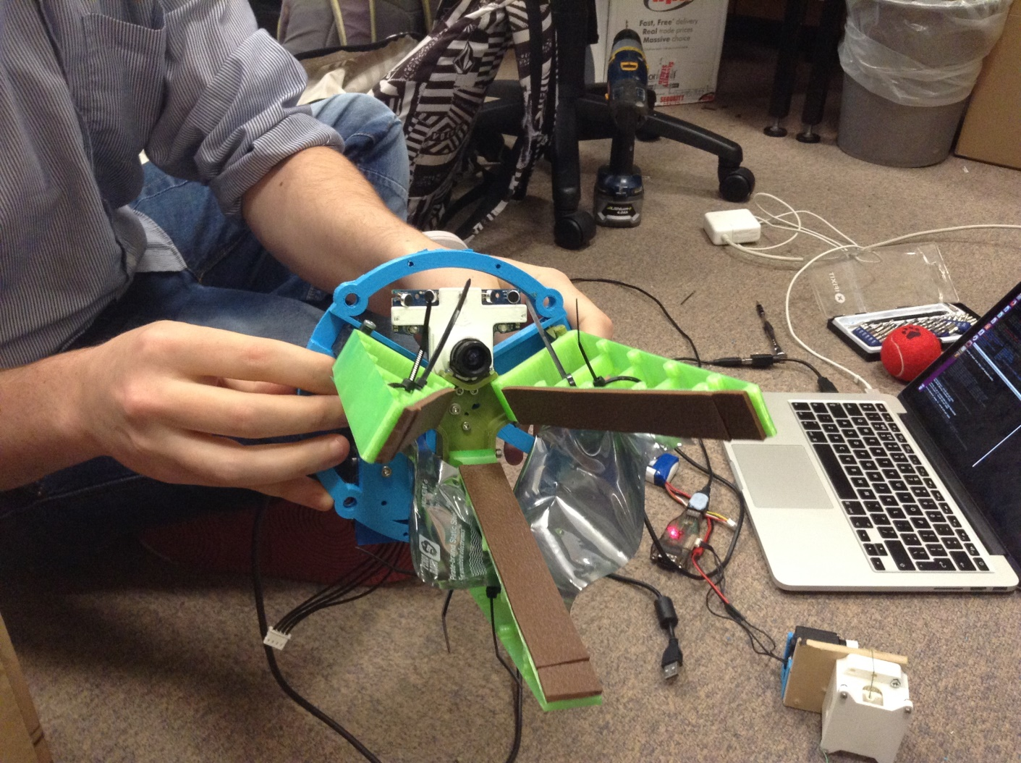
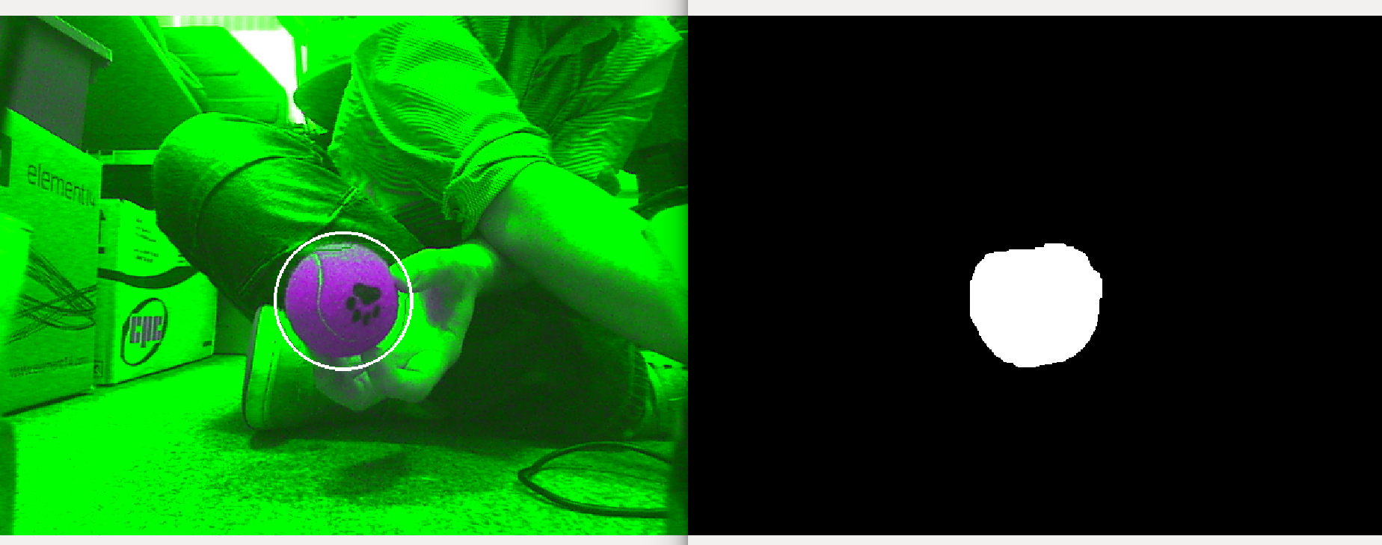

Status: Catching
Camera can reliably track from $\sim$4m away
Customise input settings via QV4L2:
Maxed out saturation & shifted hue by 45 degrees
Turned off auto gain, auto white balance & auto exposure
Manually adjust the brightness for the environment
Colour threshold in OpenCV:
Convert to HSV
Average a number of pixels within the image
Threshold using the average and an offset
Using a known object (a red tennis ball)
Circle detection
Ball size is proportional to distance away
Can catch!
Demo

Slide 5
Summary
Simulation suggests system should work
Mechanical limitations are the most prominent source of bugs
Antagonistic control potential
Bungee cord has non-linear elasticity
Motors prevent actualisation
Catching system is 90% complete
Need to attach and run tests with camera feedback
Throwback system is 40% complete
More clamps needed
Requires hardware assembly & software implementation still
(and more testing!)

Slide 6
Questions?

